Slide 1
Practical Project Pokemon
By Ridwan Kawsar

Slide 2
Technologies

Slide 3
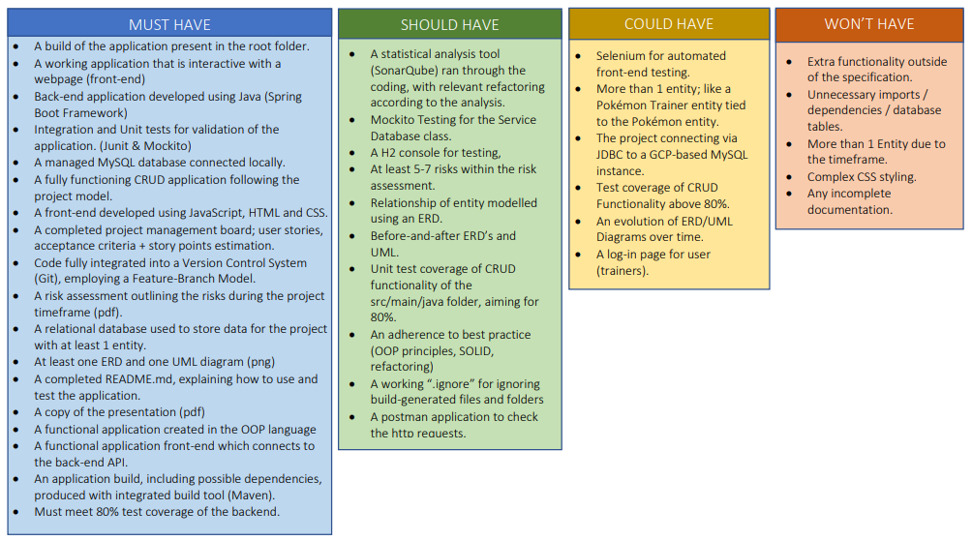
MoSCoW Prioritisation

Slide 4
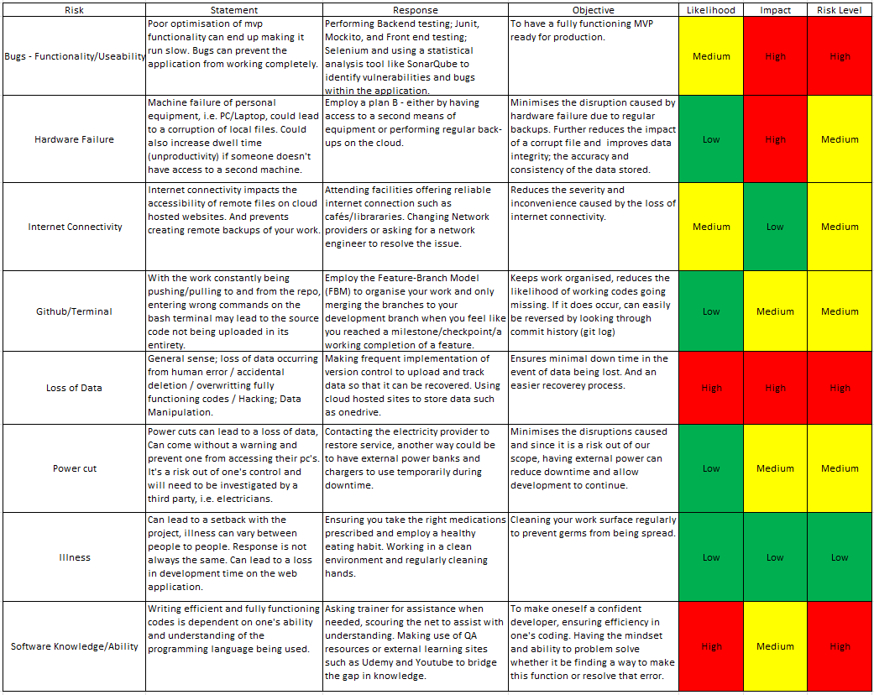
Risk Assessment

Slide 5
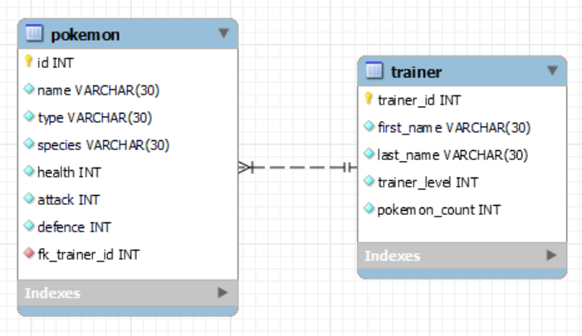
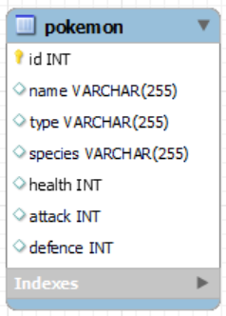
Entity Relationship Diagram (ERD) - Initial & Final

Slide 6
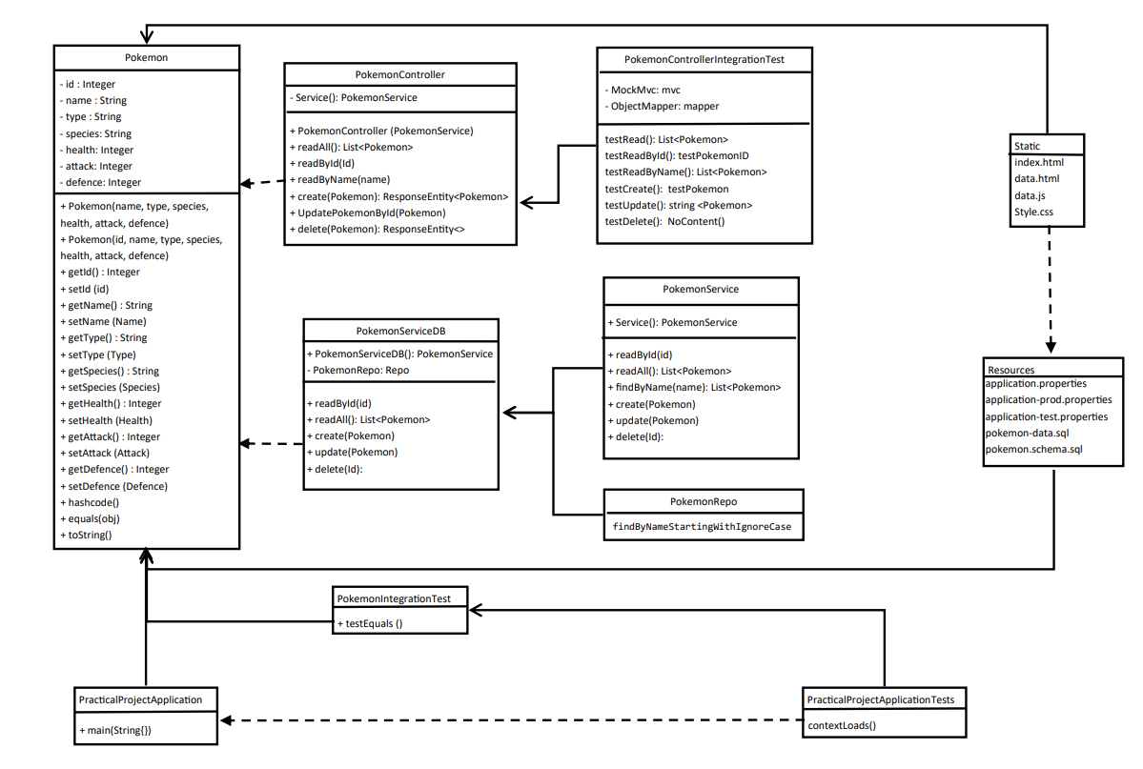
UML

Slide 7
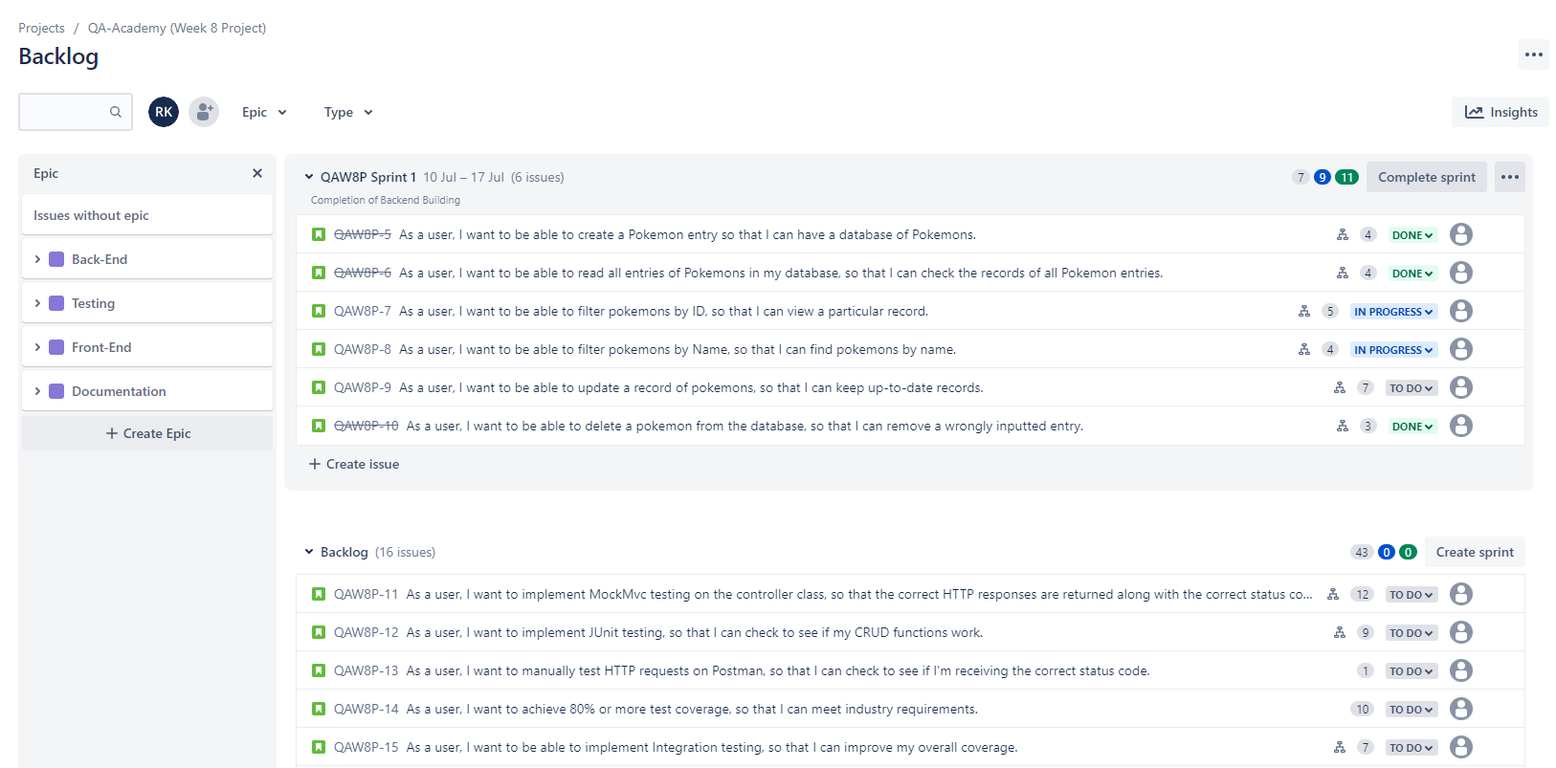
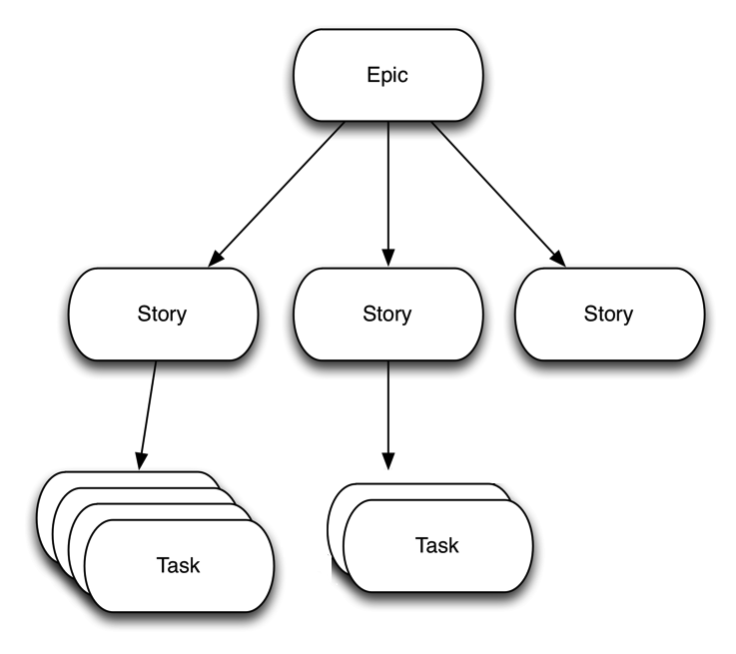
Jira Board – Epics/User Stories

Slide 8
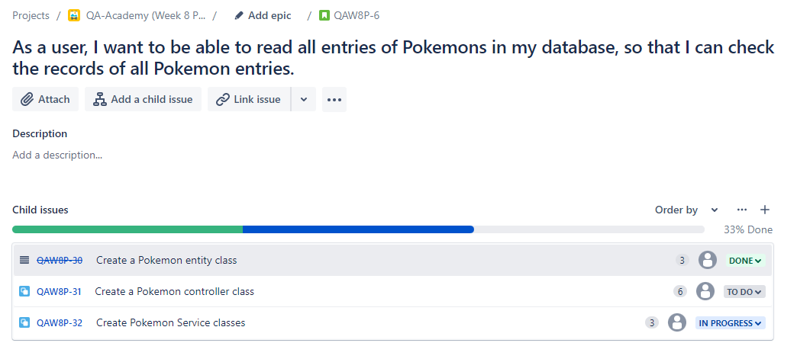
Jira Board – User Stories and Tasks

Slide 9
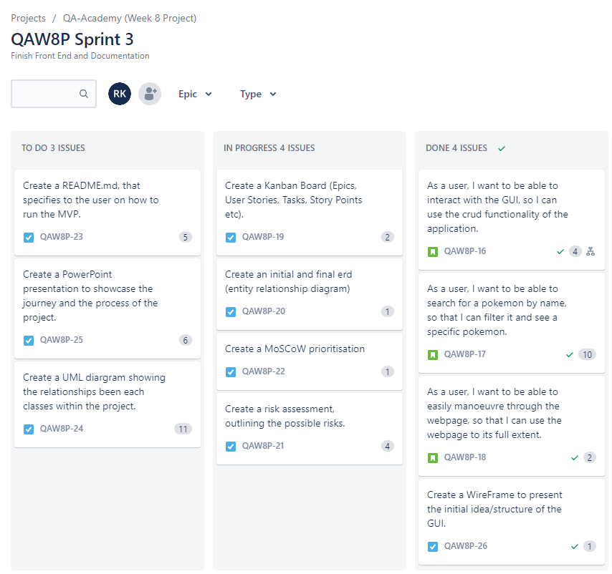
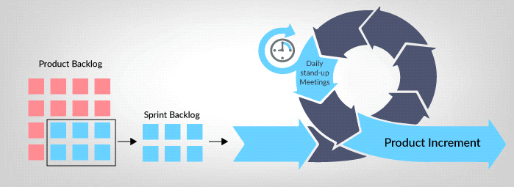
Jira Board – Sprints

Slide 10
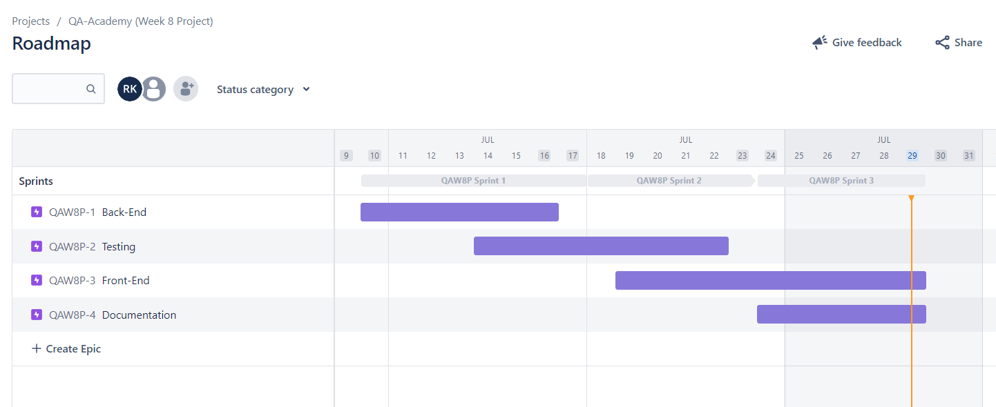
Roadmap

Slide 11
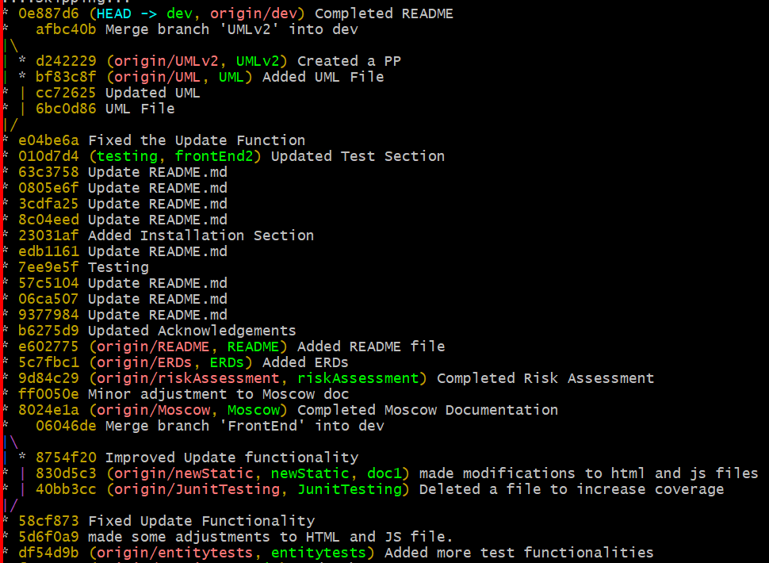
Version Control – Feature Branch Model (FBM)

Slide 12
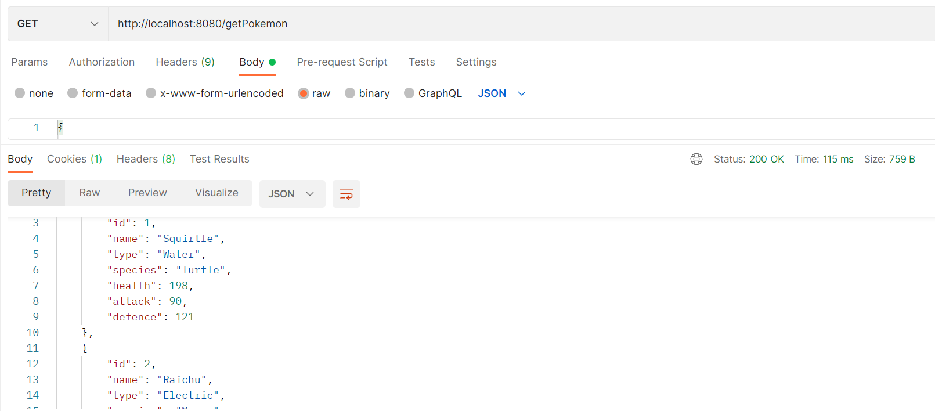
Postman

Slide 13
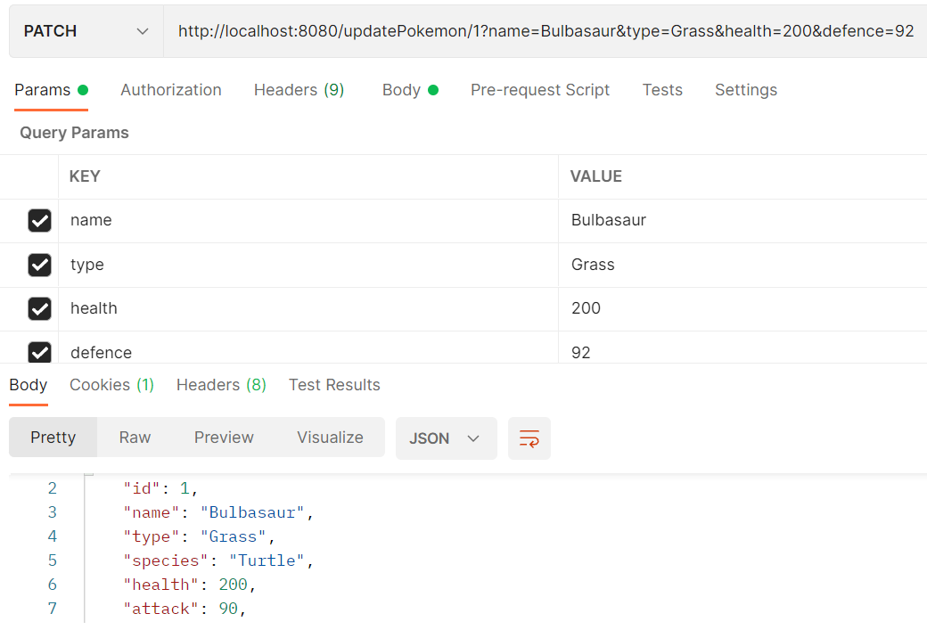
Postman Part 2

Slide 14
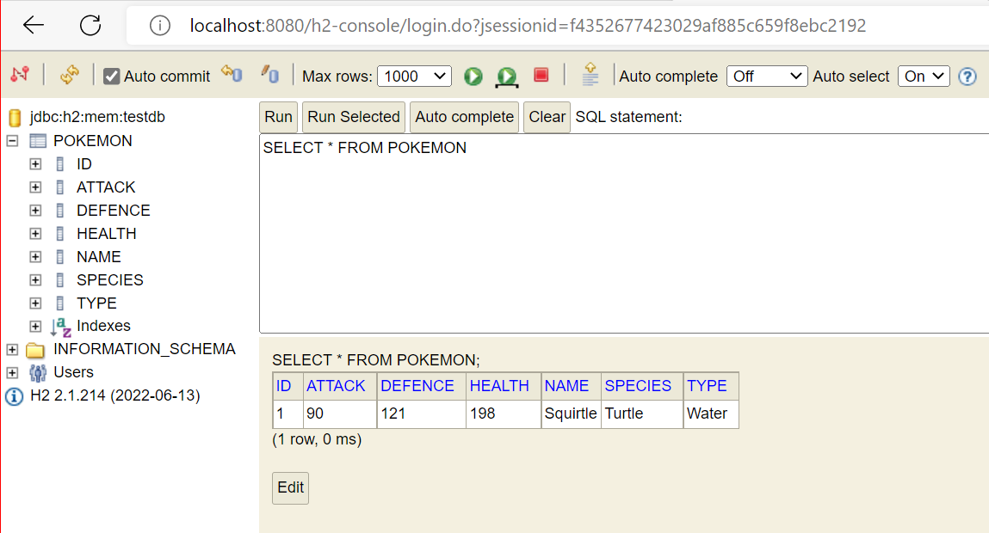
H2 Console

Slide 15
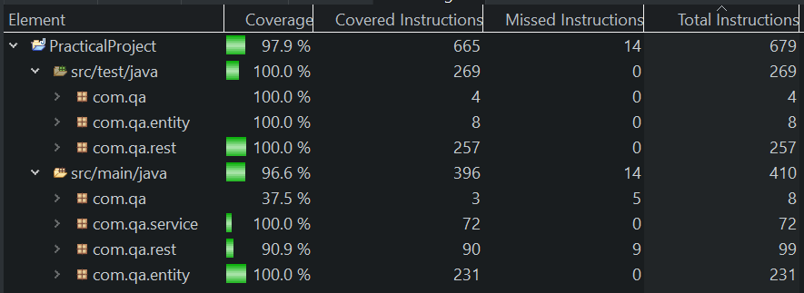
Test Coverage

Slide 16

Demo

Slide 17
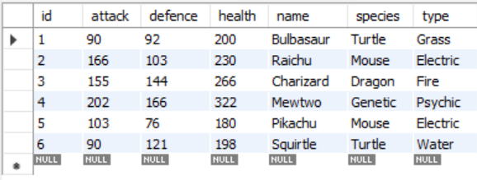
SQL Database

Slide 18

Any Questions?

